Slide 1


COURSE MATERIAL
Course : 23CSC04- Principles of Compiler Design
Module : 2 - Semantic Analysis and Intermediate Code Generation
Topic : Declarations; Assignment Statements, Boolean Expressions, Case Statements
Faculty : Ms G.Vidyasree
www.skcet.ac.in

Slide 2
Declarations-Compute the type and relative addresses of declared names
Int a; 0
A int 4
P->D D->D;D | {offset:=0}
D->id:T | {enter(id.name,T.type,offset};offset:=offset+t.width}
T->integer | {T.type:=integer; T.width:=4}
T->real | {T.type:=real; T.width:=8}
T->array[num] of T₁ | {T.type:=array(num.val,T₁.type); T.width:=num.val*T₁.width} int a[10];

Slide 3
This is a Syntax Directed Definition (SDD) to compute: >Type >Width >Relative address (offset) of declared identifiers. Let’s understand it clearly and apply it to the example: int a[10];
3️⃣ Type Rules
Integer T → integer{ T.type := integer T.width := 4}
Real T → real{ T.type := real T.width := 8}
Array T → array[num] of T1{ T.type := array(num.val, T1.type) T.width := num.val × T1.width}
1️⃣ Start Rule
P → D { offset := 0 }
👉 Before processing declarations, initialize offset = 0.
2️⃣ Declaration Rule
D → id : T { enter(id.name, T.type, offset); offset := offset + T.width; }
👉 When a variable is declared:
Store its name, type, and current offset
Increase offset by its width
int a[10];
Type of a → array(10, integer)
Width of a → 40 bytes
Relative Address (offset) → 0
Next offset value → 40

Slide 4
Declarations
T-> | {T.type:=pointer(T₁.type); T.width:=4}
T₁
Nonterminals generating ↋ called marker nonterminals.
Using a marker nonterminal M can be restated as :
P->MD
M->↋ {offset:=0}

Slide 5
Semantic rules are defined in terms of the following operations:
mktable(previous)
Creates a new symbol table and returns a pointer to the new table.
Argument previous points to previously created symbol table.
enter(table,name,type,offset)
Creates a new entry for name name in the symbol table pointed to by table.
enter places type type and relative address offset in fields within the entry.
addwidth(table,width)
Records the cumulative width of all entries in table in the header associated with this symbol table.

Slide 6
enterproc(table,name,newtable)
Creates a new entry for procedure name in the symbol table pointed to by table.
Argument newtable points to the symbol table for this procedure name.
Field Names in Record
T-> record L D end | {T.type:=record(tpo(tblptr)); T.width:=top(offset); pop(tblptr); pop(offset)}
L->↋ | {t:=mktable(nil); push(t,tblptr); push(0,offset)}

Slide 7
Assignment Statements
Translation scheme to produce three-address for assignments:
Names in the symbol table
lookup(id.name)
emit – to emit an three address statements to an output file
Grammar
P -> MD
M -> ℇ
D -> D;D | id:T | proc id; ND;S
N -> ℇ Translation scheme to generate three-address code (TAC) for assignment statements using syntax-directed definitions.

Slide 8
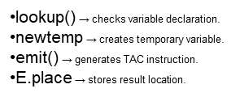
Assignment Statements
Translation scheme to produce three-address for assignments:
S->id:=E | {p:=lookup(id.name); If p ≠ nil then emit(p ’:=’ E.place) else error}
E->E₁+E₂ | {E.place:=new temp emit(E.place’:=’ E₁.Place ‘+’ E₂.Place)}
E->E₁*E₂ | {E.place:=new temp emit(E.place’:=’ E₁.Place ‘*’ E₂.Place)}
E->-E₁ | {E.place:=new temp emit(E.place’:=’ ‘uminus’E₁.Place)}

Slide 9
Addressing Array Elements
Elements of an array can be accessed quickly if the elements are stored in a block of consecutive locations
If the width of each array element is w , then the ith element of array A begins in location
base+(i-low) * w
Where low is the lower bound on the subscript and base is the relative address of the storage allocated for the array
Base is the relative address of A[low]
Expression can be partially evaluated at compile time if it is rewritten as
i*w + ( base – low*w)
Subexpression c= base – low*w, can be evaluated when the declaration of array is seen.

Slide 10
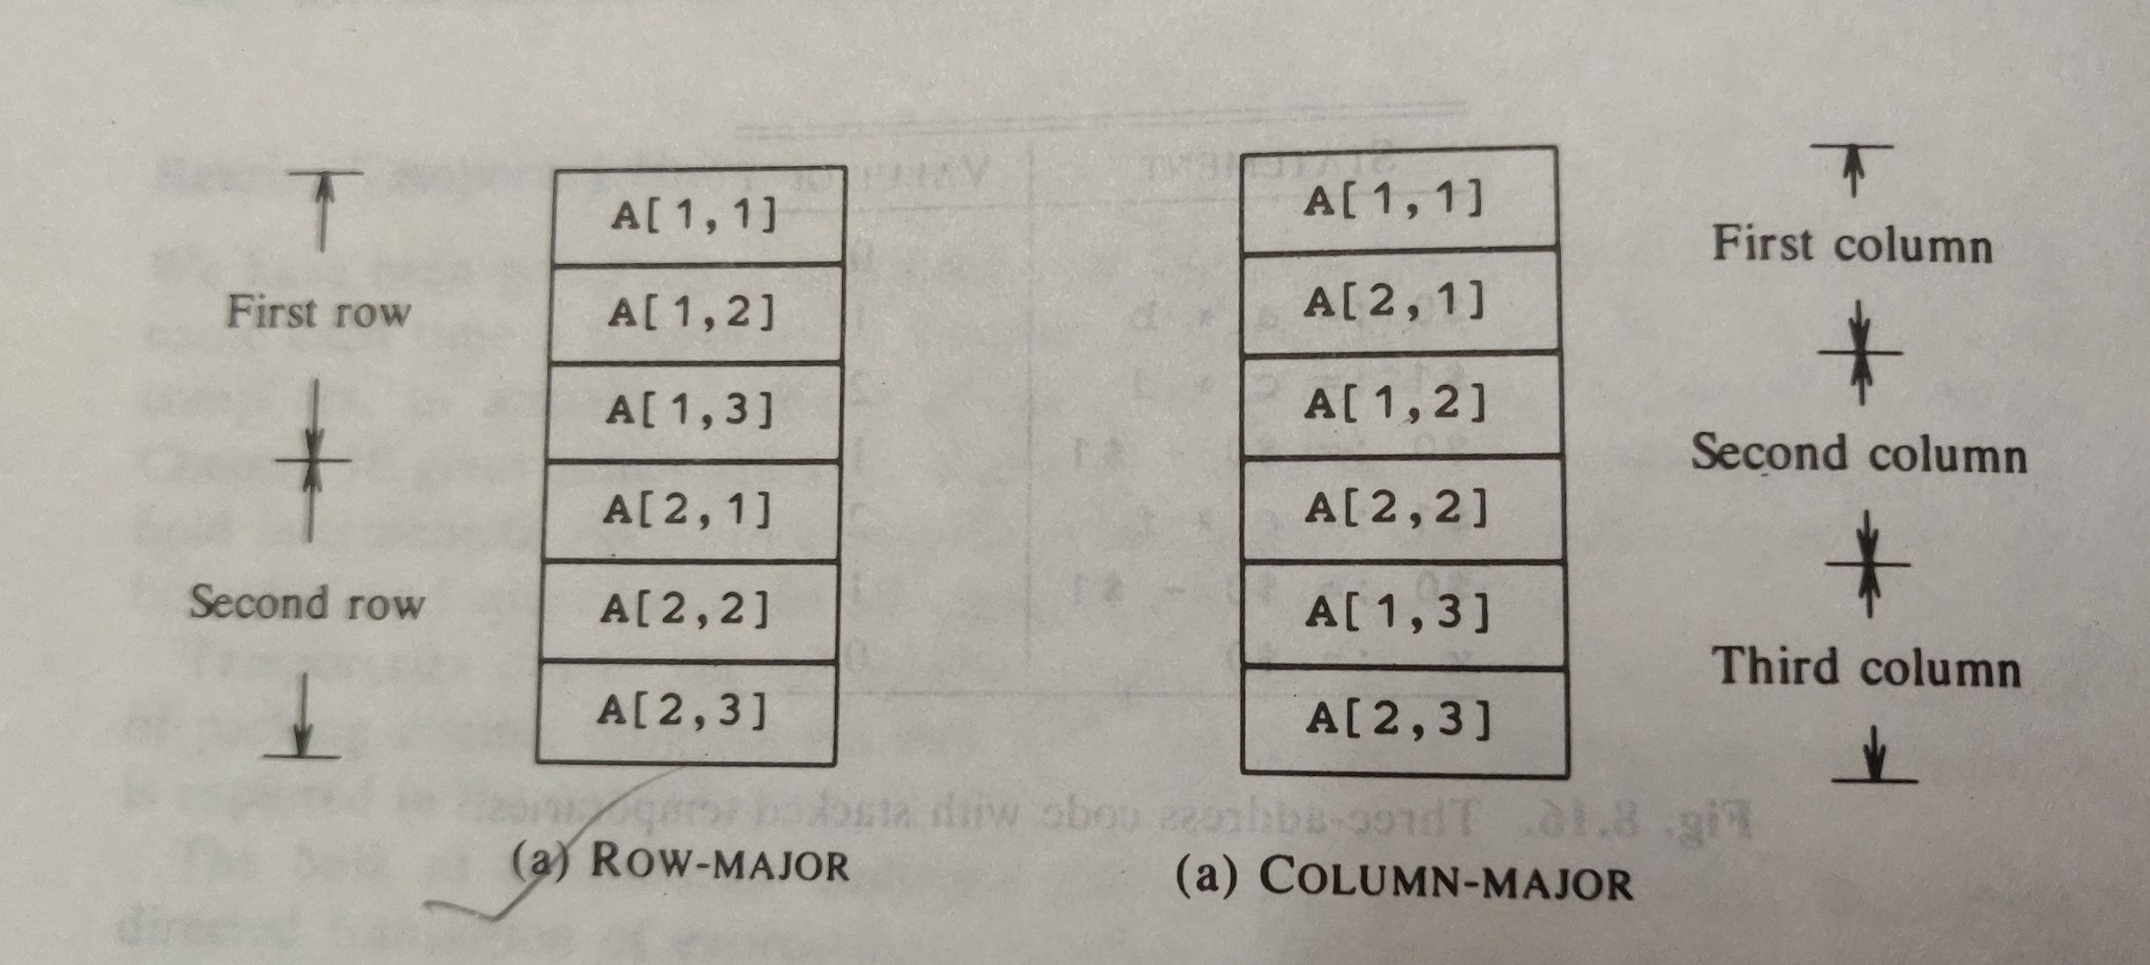
Two Dimensional Array
2D array values are stored in the memory locations either as Row – Major or as Column – Major

Slide 11
Translation scheme for addressing array elements
S -> L : = E
(2) E -> E + E
(3) E -> (E)
(4) E -> L
(5) L ->[ Elist ]
(6) L -> id
(7) Elist -> Elist, E
(8) Elist ->id [ E]

Slide 12
Syntax Directed Definition
S -> L : = E {if L.offset = null then
emit(L.place ‘:=’ E.place);
else
emit(L.place ‘[‘ L.offset ‘]’ ‘:=’ E.place) }
(2) E-> E + E { E.place:=newtemp;
emit( E.place ‘:=’ E₁.place ‘+’ E₂.place) }

Slide 13
E -> (E) { E.place := E₁.place }
Array reference reduced to E, we want the r-value of L, we use indexing to obtain the contents of the location L.place[L.offset]:
(4) E -> L { if L.offset = null then
E.place:= L.place
else begin
E.place:=newtemp;
emit(E.place‘:=’ L.place ‘[‘ L.offset ‘]’ )
end }

Slide 14
L.place represents value returned by function c(Elist.array)
(5) L -> Elist ] { L.place:=newtemp;
L.offset:=newtemp;
emit(L.place‘:=’ c(Elist.array));
emit(L.offset ‘:=’ Elist.place ‘*’ width(Elist.array)) }
Null offset indicates a simple name
(6) L -> id { L.place := id.place;
L.offset:= null }

Slide 15
(7) Elist -> Elist, E { t:=newtemp;
M:=Elist1.ndim +1;
emit( t‘:=’ Elist₁.place ‘*’ limit(Elist₁.array,m));
Elist.array:=Elist₁.array;
Elist.place := t;
Elsit.ndim:=m }
(8) Elist ->id [ E ] { Elist.array:=id.place;
Elist.place:=E.place;
Elist.ndim:=1 }

Slide 16
2D array stored in Row- Major form, the relative address of A[i₁,i₂] can be calculated by the formula
base +(i₁ – low₁ ) * n₂ + i₂ – low₂) *w
Where low₁ and low₂ are the lower bounds on the values of i₁ and i₂ and n₂ is the number of values that i₂ can take.
Assuming that i₁ and i₂ are the only values that are not known at compile time the above expression is rewritten as:
(i₁ * n₂ ) + i₂ ) * w + ( base – ((low₁ * n₂)+low₂)*w)
Major issue is generating code for array references.

Slide 17
Grammar
L -> id [ Elist ] | id
Elist -> Elist,E | E
Elist- Group of index expressions
Rewriting the above grammar for simplicity as,
L -> [Elist ] | id
Elist -> Elist, E | id [ E
Array name is attached to the leftmost index expression rather than being joined to Elist when an L is formed.
These productions allow a pointer symbol-table entry for the array name to be passed as a synthesized attribute array of Elist.

Slide 18
Assignment Statements
Translation scheme to produce three-address for assignments:
E->E₁*E₂ | {E.place:=new temp emit(E.place’:=’ E₁.Place ‘*’ E₂.Place)}
E->-E₁ | {E.place:=new temp emit(E.place’:=’ ‘uminus’E₁.Place)}
E->(E₁) | {E.place:=E₁.Place }
E->id | {p:=lookup(id.name); If p≠ nil then E.place:=p Else error}

Slide 19
Type Conversions within Assignments
E->E₁+E₂ | E.place:=newtemp; if E₁.type=integer and E₂.type=integer then begin emit(E.place’:=’ E₁.Place ‘int +’ E₂.Place); E.type:=integer end else if E₁.type=real and E₂.type=real then begin emit(E.place’:=’ E₁.Place ‘real +’ E₂.Place); E.type:=real end else if E₁.type=integer and E₂.type=real then begin U:=newtemp; emit(U ‘:=’ ‘intoreal’ E₁.Place );

Slide 20
Type Conversions within Assignments
E->E₁+E₂ | emit(E.place ‘:=’ U ‘real +’ E₂.place); E.type:=real end else if E₁.type=real and E₂.type=integer then begin U:=newtemp; emit(U ‘:=’ ‘intoreal’ E₂.place); emit(E.place ‘:=’ E₁.place ‘real +’ U); E.type:=real end else E.type:=type_error;

Slide 21
Boolean Expression
E->E₁or E₂ | {E.place:=new temp emit(E.place’:=’ E₁.Place ‘or’ E₂.Place)}
E->E₁and E₂ | {E.place:=new temp emit(E.place’:=’ E₁.Place ‘and’ E₂.Place)}
E->not E₁ | {E.place:=new temp emit(E.place’:=’ ‘not’ E₁.Place )}
E->(E₁) | {E.place:=E₁.Place }

Slide 22
E->id₁ relop id₂ | {E.place:=newtemp; emit(‘if’ id₁.place relop id₂.place ‘goto’ nextstat+3); emit(E.place ‘:=’ ‘0’); emit(‘goto’ nextstat+2); emit(E.place ‘:=’ ‘1’);
E->true | {E.place:=newtemp; emit(E.place ’:=’ ‘1’)}
E->false | {E.place:=newtemp; emit(E.place ’:=’ ‘0’)}

Slide 23
Example
a or b and not c
Three-address code
t₁:= not c
t₂:=b and t₁
t₃:= a or t₂
Relational expression
if a<b then 1 else 0
Three-address code
100: if a<b goto 103
101: t:=0
102: goto 104
103: t:=1
104:
{E.place:=newtemp;
emit(‘if’ id₁.place relop id₂.place ‘goto’ nextstat+3);
emit(E.place ‘:=’ ‘0’);
emit(‘goto’ nextstat+2);
emit(E.place ‘:=’ ‘1’);

Slide 24
a<b or c<d and e<f
Three- address code
E->E₁or E₂
{E.place:=new temp
emit(E.place’:=’ E₁.Place ‘or’ E₂.Place)}
100: if a < b goto 103
101: t₁:=0
102: goto 104
103: t₁:=1
104: if c < d goto 107
105: t₂:=0
106: goto 108
107:t₂:=1
108:if e < f goto 111
109: t₃:=0
110:goto 113
111:t₃:=0
112:t₄:=t₂ and t₃
{E.place:=newtemp;
emit(‘if’ id₁.place relop id₂.place ‘goto’ nextstat+3);
emit(E.place ‘:=’ ‘0’);
emit(‘goto’ nextstat+2);
emit(E.place ‘:=’ ‘1’);
113: t₅:=t₁ or t₄
E->E₁and E₂ | {E.place:=new temp emit(E.place’:=’ E₁.Place ‘and’ E₂.Place)}

Slide 25
a<b or c<d and e<f
Three- address code
100: if a<b goto 103
101: t₁:= 0
102: goto 104
103: t₁:= 1
104: if c<d goto 107
105:t₂:=0
106:goto 108
107:t₂:=1
108: if e<f goto 111
109:t₃:= 0
110: goto 112
111: t₃:=1
112: t₄:=t₂ and t₃
113:t₅:=t₁ or t₄

Slide 26
Tutorial
Write the three address code for
if(g>h) and (i<j) or(l>m)

Slide 27
Short-Circuit Code
Flow- of - Control Statements
S->if E then S₁
| if E then S₁ else S₂
| while E do S

Slide 28
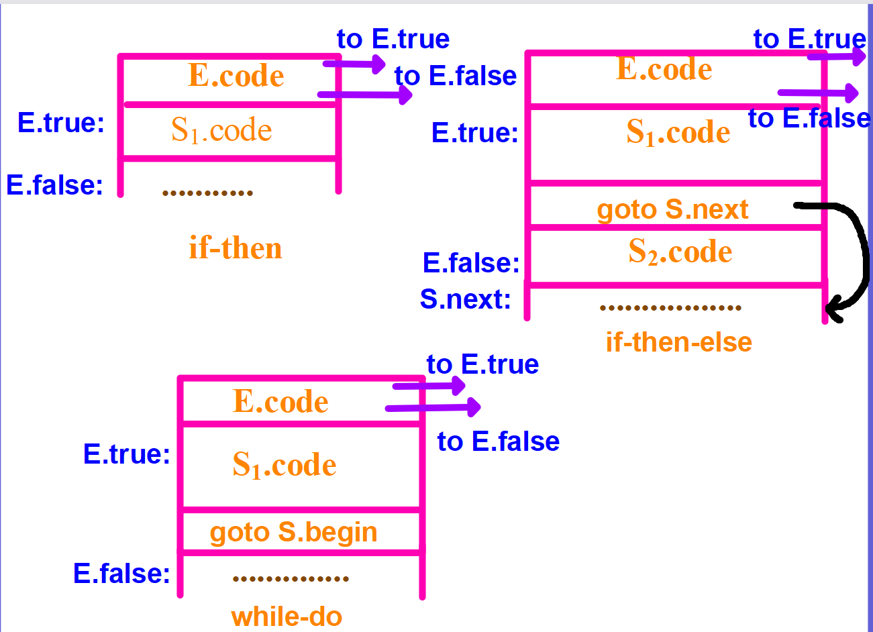

Slide 29
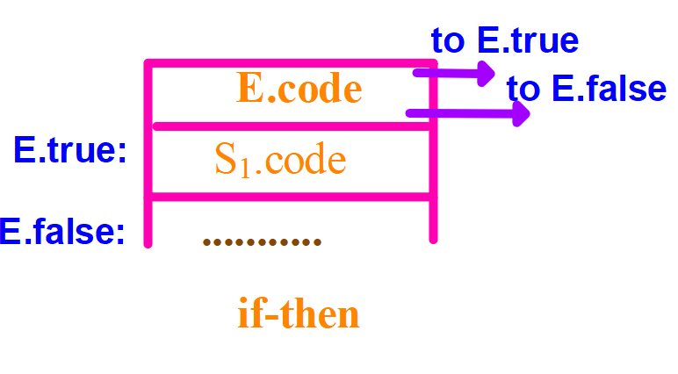
Syntax-directed definition for flow-of-control statements
S->if E then S₁ | E.true:=newlabel; E.false:=S.next; S₁.next:=S.next; S.code:=E.code|| gen(E.true’:’) ||S₁.code

Slide 30
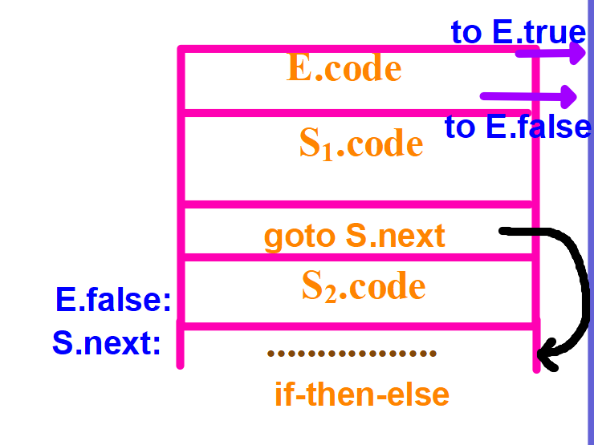
Syntax-directed definition for flow-of-control statements
S->if E then S₁ else S₂ | E.true:=newlabel; E.false:=newlabel; S₁.next:=S.next; S₂.next:=S.next; S.code:=E.code|| gen(E.true’:’) ||S₁.code|| gen(‘goto’ S.next) || gen(E.false’:’) ||S₂.code

Slide 31
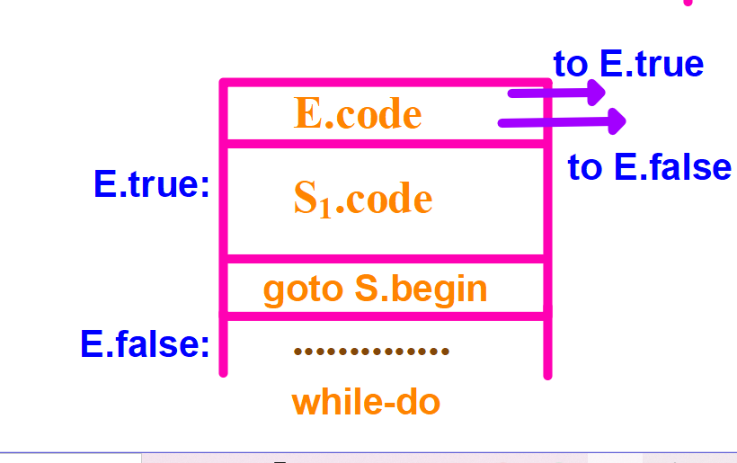
Syntax-directed definition for flow-of-control statements
S->while E do S | S.begin:=newlabel; E.true:=newlabel; E.false:=S.next; S₁.next:=S.begin; S.code:=gen(S.begin’:’)|| E.code|| gen(E.true’:’) ||S₁.code|| gen(‘goto’ S.begin)

Slide 32
Case Statements
Translation of a switch is code to:
Evaluate the expression.
Find which value in the list of cases is the same as the value of the expression. Recall that the default value matches the expression if none of the values explicitly mentioned in cases does.
Execute the statement associated with the value found.

Slide 33
Switch statement syntax
Switch expression
begin
case value: statement
case value: statement
case value: statement
case value: statement
….
case value: statement
end

Slide 34
Syntax Directed Translation
switch E
begin
case V₁: S₁
case V₂: S₂
…
case V_{n-1}: S_{n-1}
default: S_{n}
end

Slide 35
Syntax Directed Translation of a Case Statement
code to evaluate E into t
goto test
L₁: code for S₁
goto next
L₂: code for S₂
goto next
….
L_{n-1}: code for S_{n-1}
goto next
L_{n}: code for S_{n}
goto next
test: if t= V₁ goto L₁
if t= V₂ goto L₂
….
if t= V_{n-1} goto L_{n-1}
goto L_{n}
next:

Slide 36
Thank You!!!!!!

